Slide 1
Tiaxa
FARMER CREDIT SCORING
(PRABHU)
INITIAL EXPLORATORY DATA ANALYSIS

Slide 2
Data Source: GetWalletDetails
2.
2. There are columns with multiple data types.
Example: for the Birthday there are Date, String, Integer, and decimal data types.
There are 555 columns & 37 rows in this data source.
1.
1. These are the number of nulls that existed in each of the column for this dataset.

Slide 3




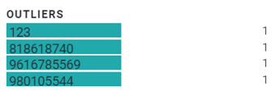
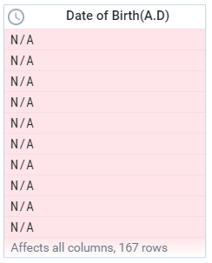
GetWalletDetails - DATA INCONSISTENCY & DISCREPANCY
Name
Date of Birth (A.D)
Mobile
3.
4.
5.
3. For the names there are about:
-18 counts missing for the month of February.
-7 counts for the month of March.
-3 counts for the month of April.
4. There is also 167 points for Date of Birth (A.D.) that are missing.
5. There are also discrepancies in the mobile number:
- There are numbers with three digits only: 123.
There are numbers that starts with 8 while other starts with 96 and 98.
Some numbers are 9 digits long while others are 10 digits long.

Slide 4
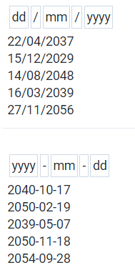
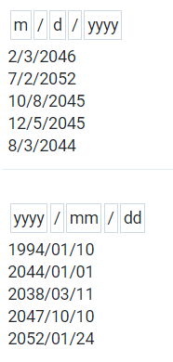
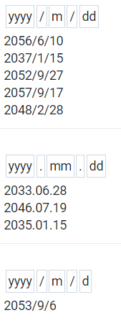
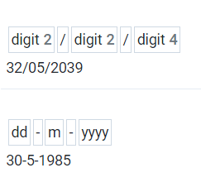

GetWalletDetails - DATA INCONSISTENCY & DISCREPANCY
Date of Birth (B.S)
Hold Amount
6.
7.
7. There are negative Hold Amounts
6. The date datasets are not standardized
Mother’ Name, Father’s Name, & Grandfather’s Name
8.
8. Mother’s name and Father’s name are gibberish words, consisting of strings.

Slide 5

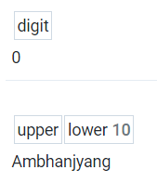

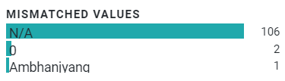
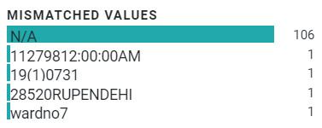
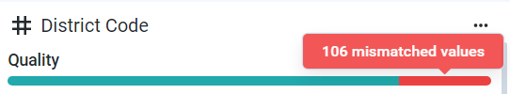

GetWalletDetails - DATA INCONSISTENCY & DISCREPANCY
Local Body Code
Identification
9.
10.
9.The Local Body Code contains:
A zero value
A word: Ambhaniyang
N/A’s
10. Identification contains:
A word
Alphanumeric
NA’s
Numbers in parentheses
District Code
11.
11. The District Code contains a zero value.

Slide 6





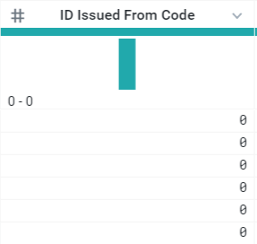
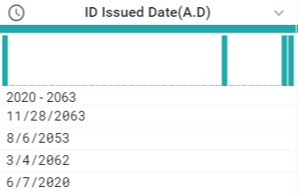

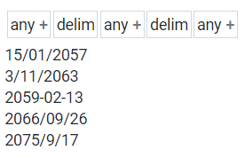
GetWalletDetails - DATA INCONSISTENCY & DISCREPANCY
ID Issued From Code
ID Issued Date (A.D)
11.
12.
12. We would like to clarify if these dates are the ones followed in Nepal. Ranging from 2020 to 2063.
11. ID Issued from Code contains:
A Missing value.
6 entries of 0 value
N/A values.
13.
ID Issued Date (B.S)
Date data contains word
5 missing values

Slide 7



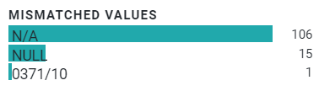

GetWalletDetails - DATA INCONSISTENCY & DISCREPANCY
State Code
Ward No
14.
14. State code has 106 missing values
15. Ward code has:
106 “N/A” values.
15 Null values
an alphanumeric.
Is it safe to assume that N/A and NULL dataset are one and the same?

Slide 8



GetWalletDetails - DATA INCONSISTENCY & DISCREPANCY
Address
Email
16.
17.
17. 29 N/A values, does this mean they do not have emails?
Device Type
18.
16. Addresses have 7 empty values.
18. What does device type ”0” mean, does it mean android or IOS, or does it mean it has a mobile phone or no mobile phone?

Slide 9
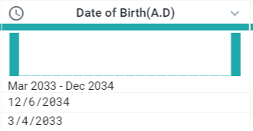
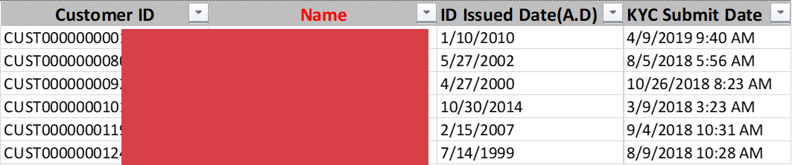
GetWalletDetails - DATA INCONSISTENCY & DISCREPANCY
19.
20.
20. Clarification on “ID Issued Date”, is earlier than the “KYC Submit Date”?
And
Is the KYC Submit Date in A.D or in B.S?
19. Some dates in Date of Birth A.D. is advance

Slide 10
Data Source: GetWalletTXNDetails
This data source has 10 columns and 34,912 rows.
1. Amount is in string due to the presence of the prefix R.S.

Slide 11


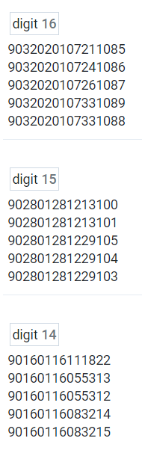
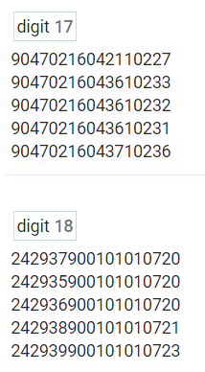
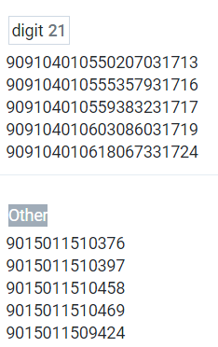


GetWalletTXNDetails - DATA INCONSISTENCY & DISCREPANCY
TXN ID
Subscriber
4. In Subscriber there are 167 missing data points.
eMail
5. In eMail there are 2173 missing data points, does this mean that they do not have an email?
TXN Status
2. In the TXN ID we found out that:
-The digit length ranges from 13 to 21.
- There is 1 missing value, does this mean that there are times that a TXN ID is not issued?
6. Some data points are numeric but some contains the string “NE” or “LO”.

Slide 12

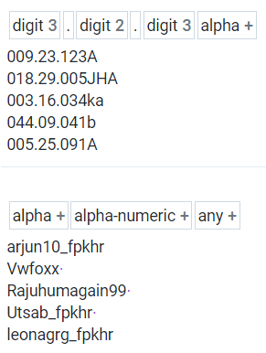
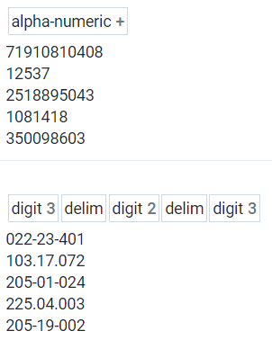
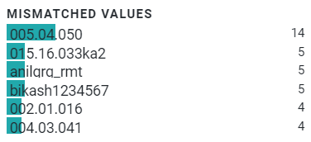

GetWalletTXNDetails - DATA INCONSISTENCY & DISCREPANCY
Consumer ID
7. In Consumer ID:
there are 815 mismatched values, some are in words, others are in numbers others are in alphanumeric. Are these the standard operating procedure?
8. In Consumer ID:
there are 27,249 missing values.

Slide 13

GetWalletTXNDetails - DATA INCONSISTENCY & DISCREPANCY
Amount
Payout Amount
TXN Status
11. In TXN Status:
What do these number mean? Which are success, which are failed?
9. In Amount:
The “Rs.” prefix has forced the data type into string instead of decimal.
This can be easily fixed.
10. In Payout Amount:
Is it safe to assume that these currencies are also in Rs?

Slide 14
Data Source: GetRemittanceDetails
This data source has 12 columns and 799 rows.
In the Receiver ID Number:
- We found that some data are strings while some are numeric.

Slide 15



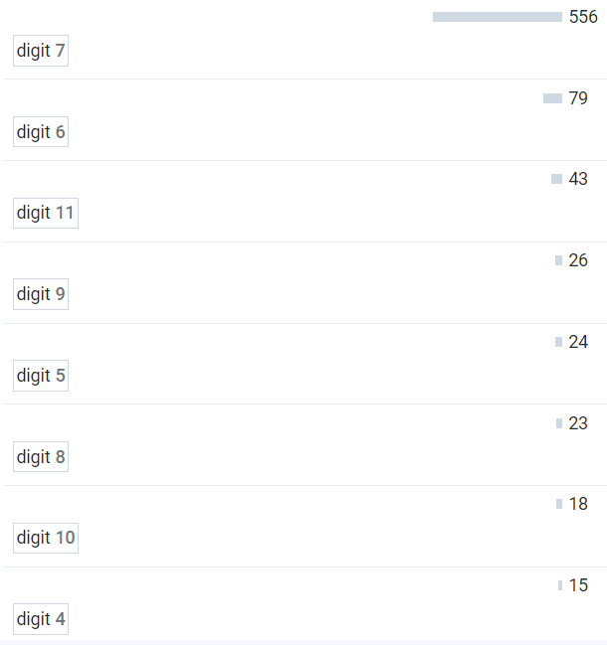
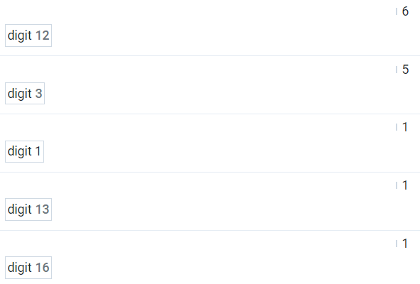
GetRemittanceDetails - DATA INCONSISTENCY & DISCREPANCY
Paid Date
Receiver ID Number
2. Please confirm id there is only 1 entry for 2018 in this sample dataset.
3. In Receiver ID Number:
- One mismatch consisting of alphanumeric while the rest are numeric.
Receiver ID Type
Different length of numbers. From 1-digit to 16-digit
Min digit
Max digit
4. In Receiver ID Type:
- Different formats of the word passport, but this can easilty be solved.
5. In Receiver ID Number:
- There are different lengths. Some digits have a minimum of 1, while and a maximum of 16, is this also an SOP in giving the “Receiver ID Number”?

Slide 16
Data Source: GetCoopCBSDetails
This data source has 10 columns and 526 rows.
1. In Number:
- We found that some datasets are integer while some are strings. Kindly confirm.

Slide 17
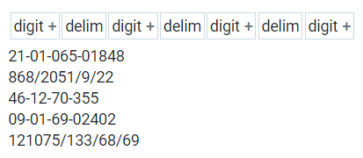
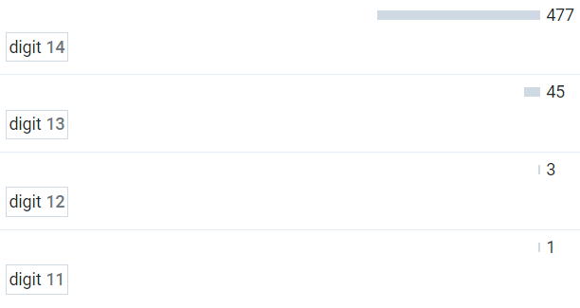
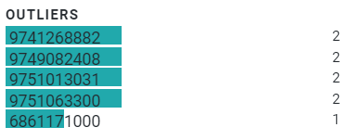
GetCoopCBSDetails - DATA INCONSISTENCY & DISCREPANCY
ID Number
A/C Number
2. In Number:
- We also found that there are many variations in writing the ID number, please confirm.
Mobile
3. In Mobile:
- Some numbers starts with 98, others starts with 97, and other starts with 68, please confirm
4. In A/C Number:
- The lengths are variable, the minimum is 11 while others are 14. Please confirm

Slide 18
Data Source: GetAccountHistoryofSaving
This data source has 5 columns and 2,820 rows.
There are blank values in these highlighted columns.

Slide 19

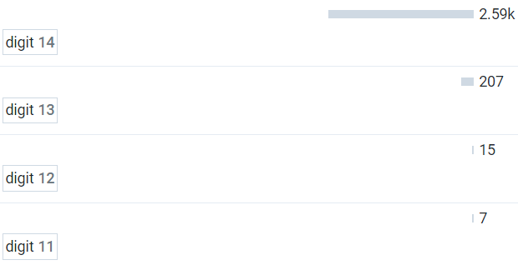


GetAccountHistoryofSaving - DATA INCONSISTENCY & DISCREPANCY
DR
A/C Number
3. Some A/C Number have a varying length ranging from 11 to 14.
2. For DR there are 1,715 missing values
CR
Balance
4. For CR there are 1,624 missing values
5. For Balance there are 1,624 missing values

Slide 20
GetAccountHistoryofLoan
This data source has 5 columns and 559 rows.
We found out that:
A/C Number is recognized as a string.
There are 348 blanks in DR.
There are 211 blanks in CR

Slide 21
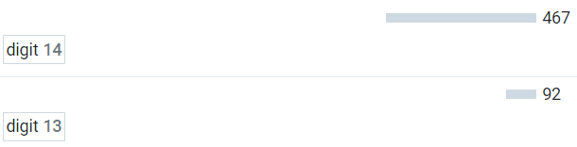


GetAccountHistoryofLoan - DATA INCONSISTENCY & DISCREPANCY
DR
CR
A/C Number
2. DR has 348 missing values.
3. CR has 211 missing values
4. A/C Number has a varying length some have 13 while others have 14.

Slide 22
Data Source: GetDairyActivities
This data source has 9 columns and 148 rows.
This has been recognized as a string due to the ”ltrs.” suffix, but this can be easily fixed.

Slide 23
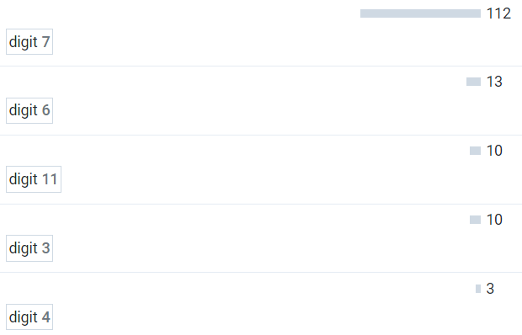
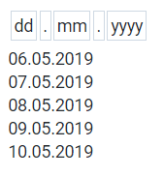
GetDairyActivities - DATA INCONSISTENCY & DISCREPANCY
Quantity
ID Number
1. This has been recognized as a string due to the ”ltrs.” suffix, but this can be easily fixed.
Date
2. Is this a way the standardized the dates of all data sources? Say all data sources will have the MM-DD-YYYY format.
4. ID Number have a varying length ranging from 3 to 112.

Slide 24
Data Source: GetAgroActivities
This data source has 10 columns and 577 rows.
1. This has been recognized as a string due to the ”Kg.” suffix, but this can be easily fixed.

Slide 25
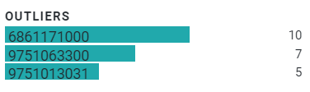

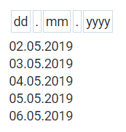
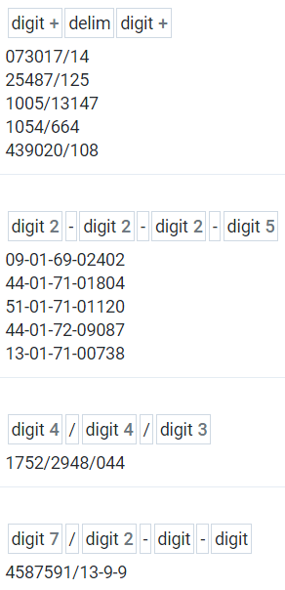
GetAgroActivities - DATA INCONSISTENCY & DISCREPANCY
ID Number
Mobile
Date
2. Some mobile starts with 6, some with 97, some with 98, please confirm.
4. There are many variation to the ID Number, please confirm if this is a standard way of providing ID Numbers.
Quantity
3. Is this a way the standardized the dates of all data sources? Say all data sources will have the MM-DD-YYYY format.
2. This has been recognized as a string due to the ”Kg.” suffix, but this can be easily fixed.

